Slide 1
Journey
Map
Deepthi Peter
Associate Data Engineer

Slide 2
PySpark (25/09/2023)
Key Learnings:
PySpark SQL Functions for Dataframe operations
col()
when()
coalesce()
sum()

Slide 3
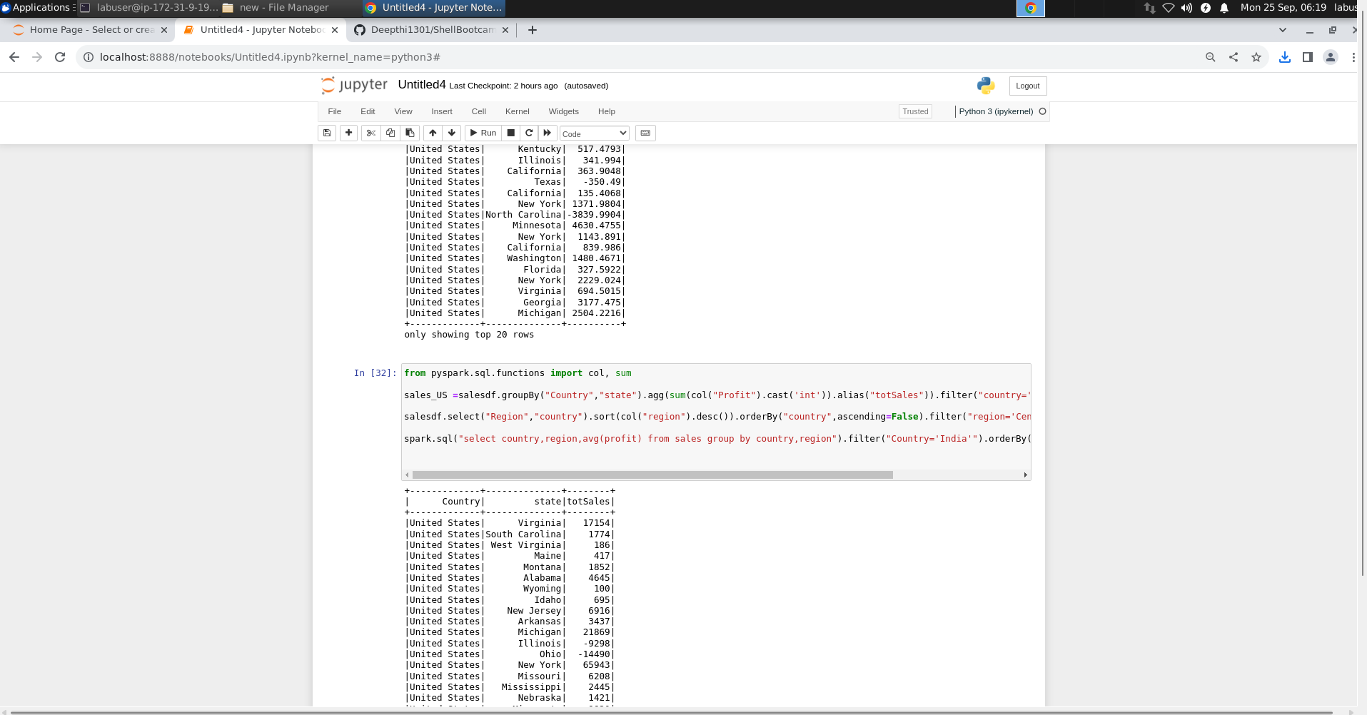
Dataframe operations using PySpark

Slide 4
Azure Databricks (26/09/2023)
Key Learnings:
Creating a Databricks workspace
Creating clusters
Running a notebook on databricks
Running SQL command on a databricks notebook

Slide 5
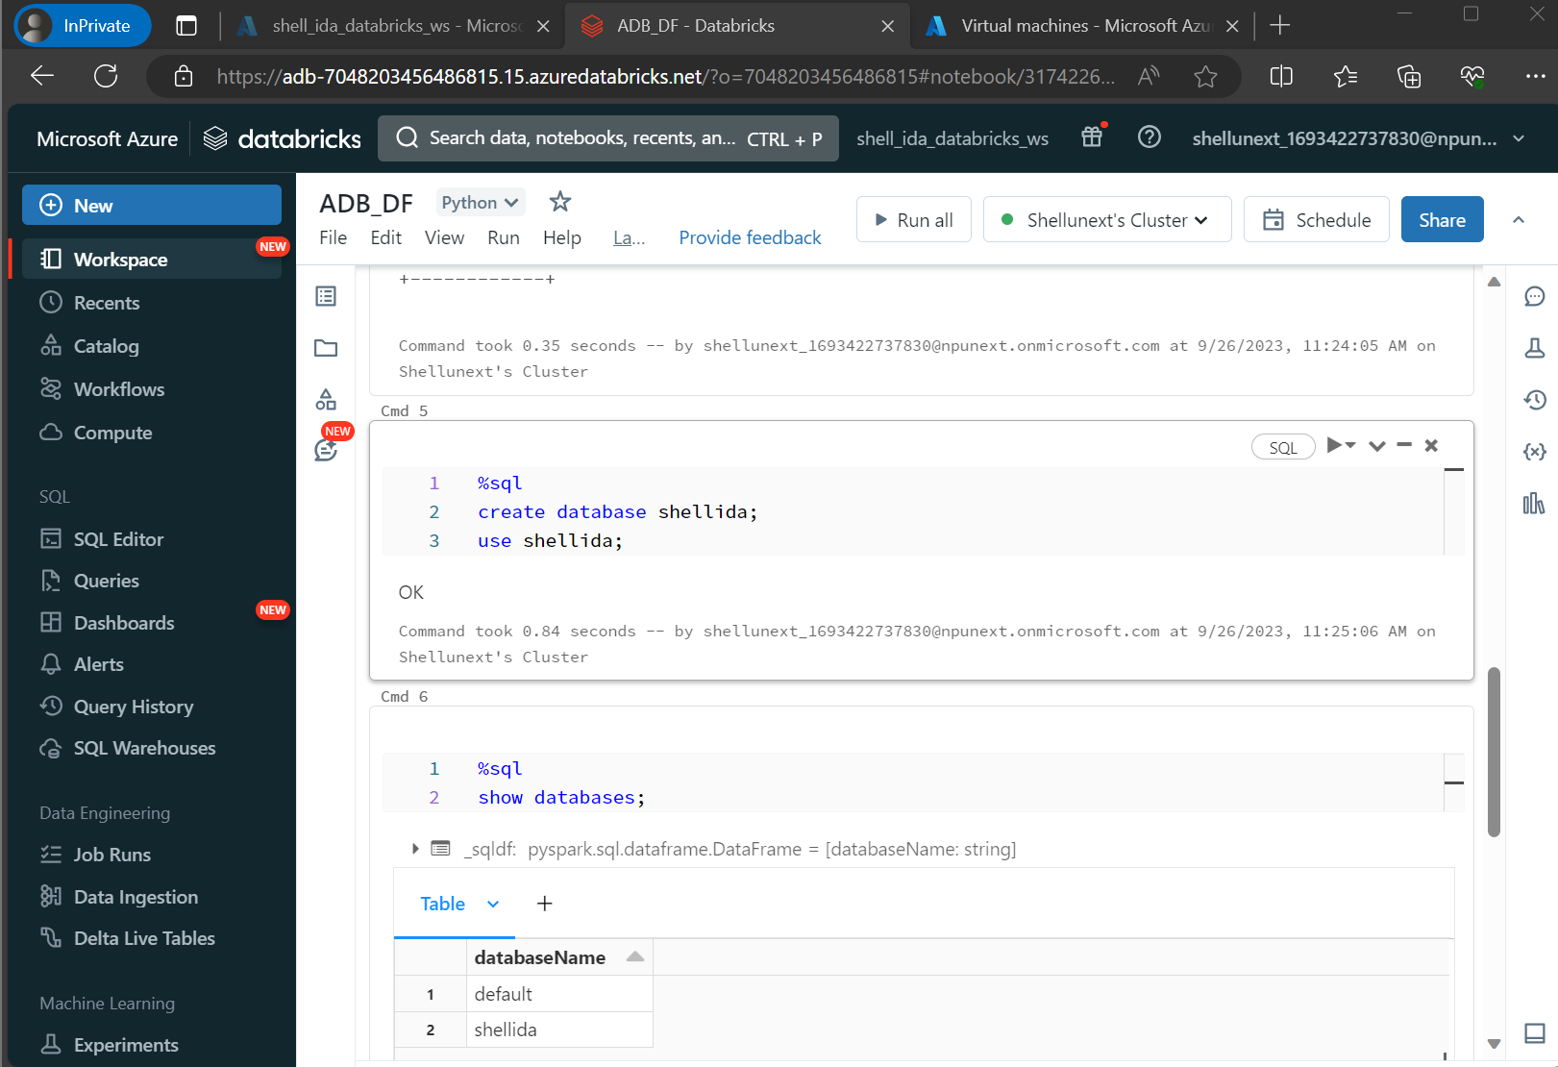
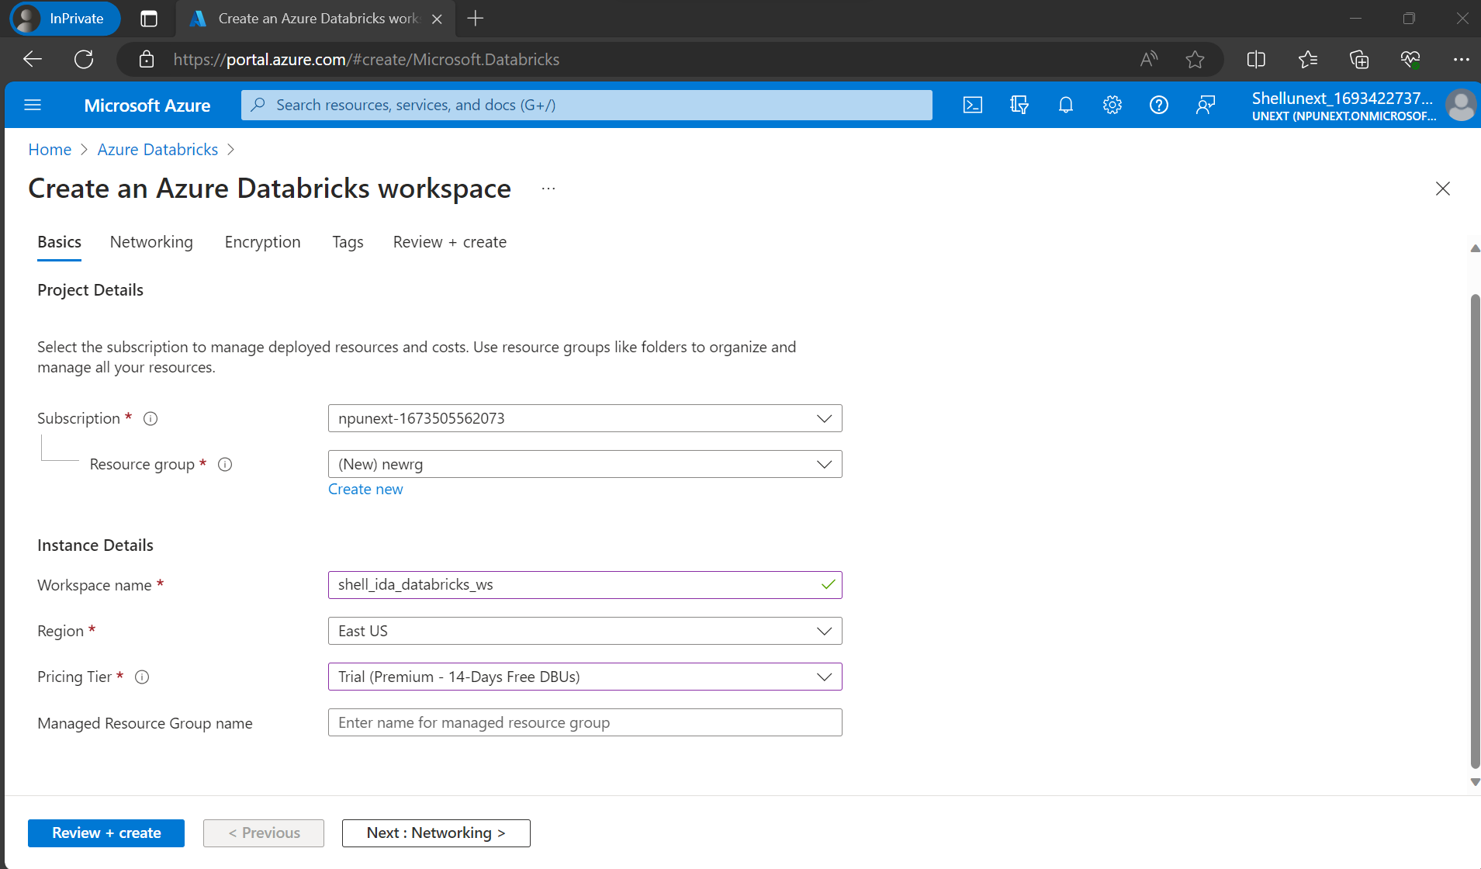
Create a Databricks Workspace
Databricks notebook

Slide 6
Docker and Azure Container Registry (29/09/2023)
Key Learnings:
Containerization
Docker - Docker is an open platform for developing, shipping, and running applications using containers
Docker CLI commands
Azure container registry

Slide 7
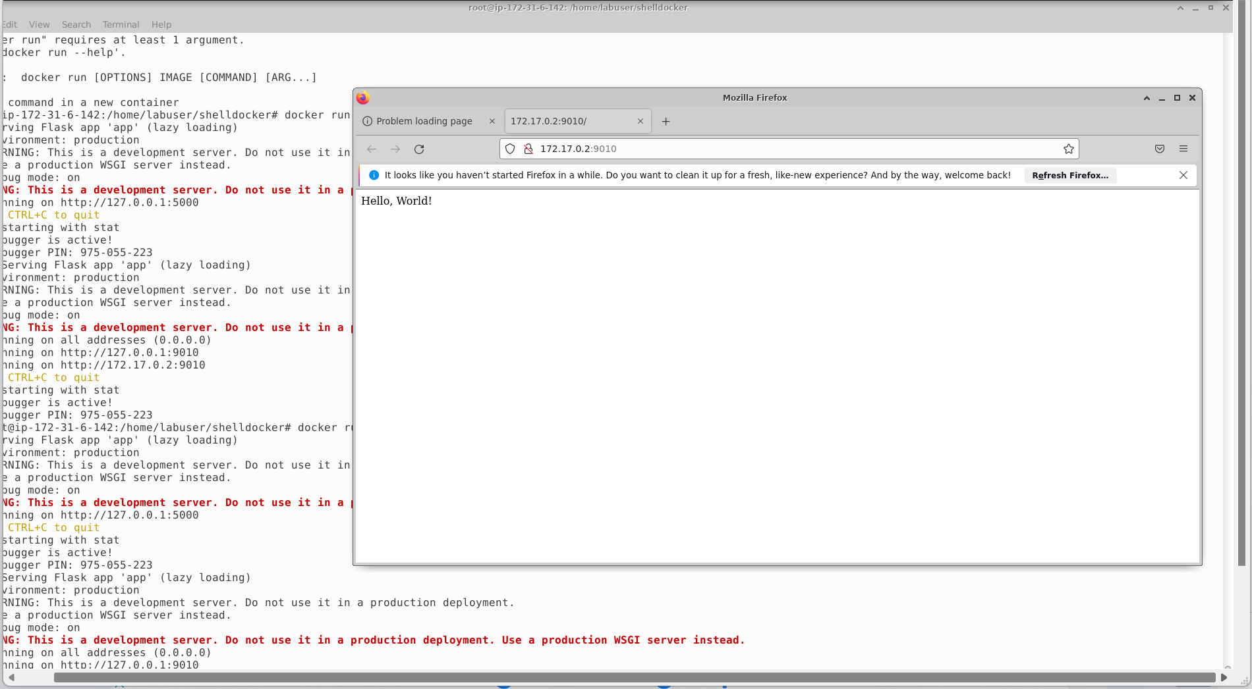
Dockerized Python application

Slide 8
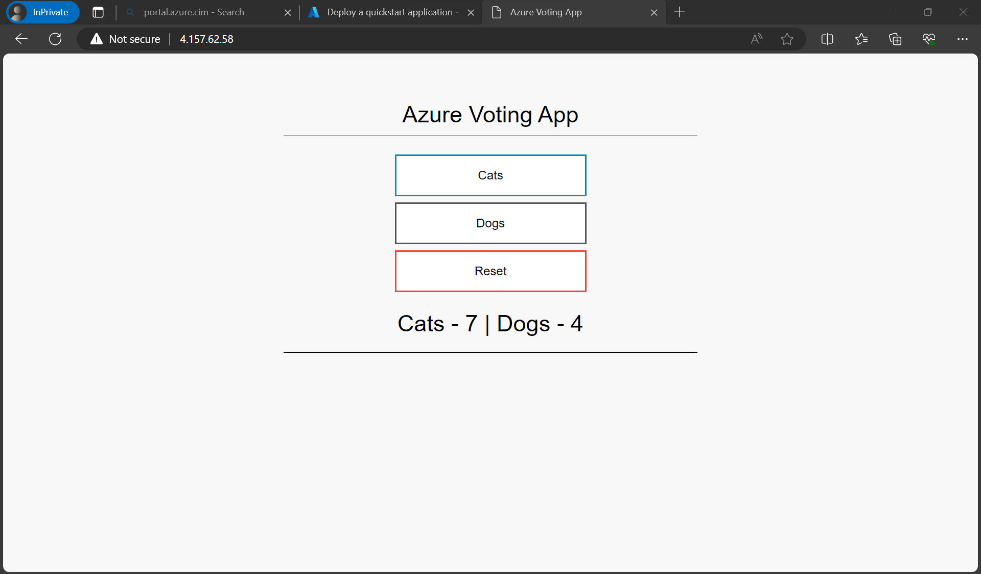
Sample web application

Slide 9
Azure DevOps (29/09/2023)
Key Learnings:
Creating projects on Azure DevOps
Cloning from a GitHub repository to Azure DevOps
Running pipelines

Slide 10
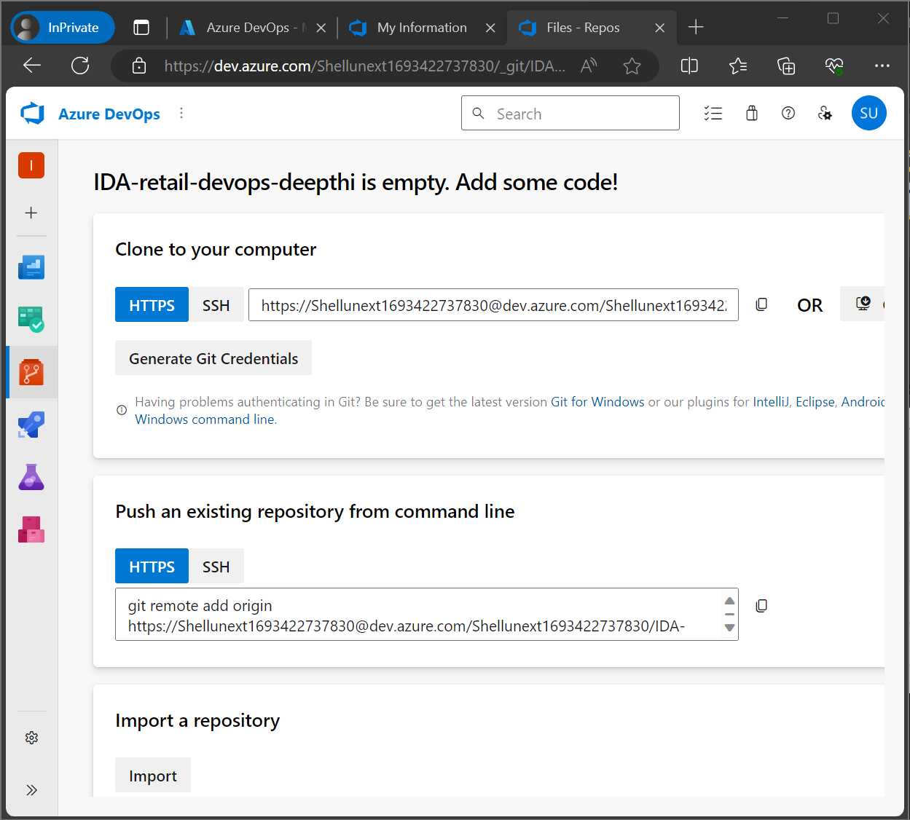
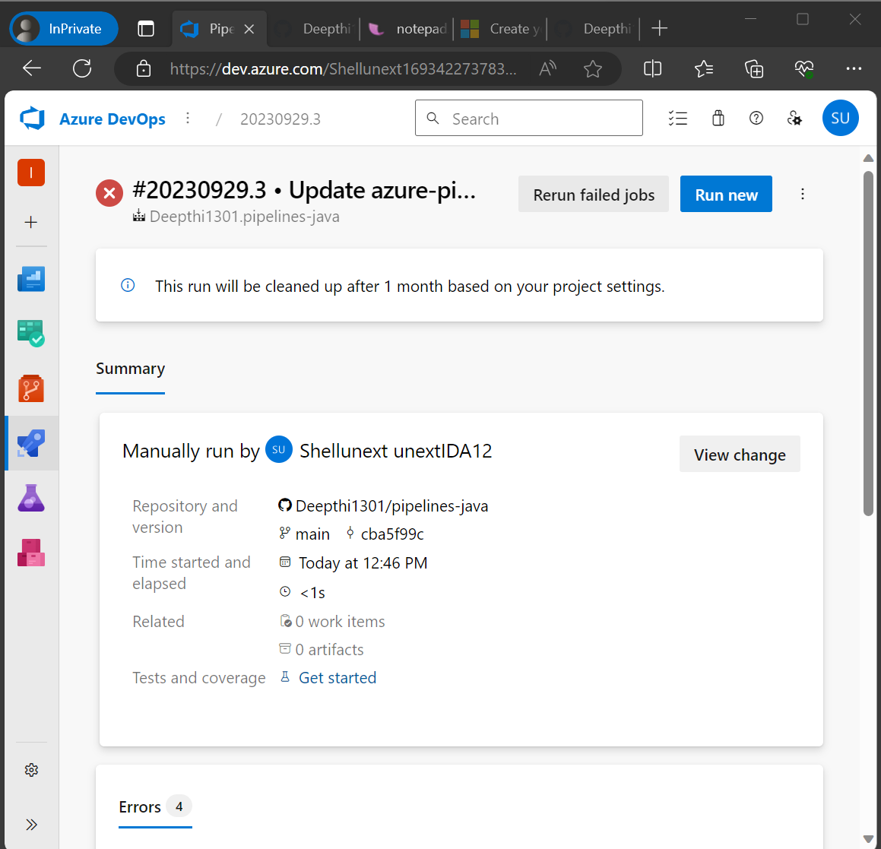
Create Project on Azure DevOps
Run pipelines

Slide 11
Thank You

